Slide 1
Nonlinear properties calculation for Gold
Xiao Chen
22/07/2022

Slide 2
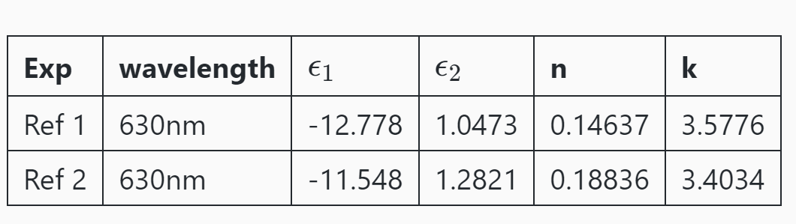
Linear Experimental data
[Ref1] https://refractiveindex.info/?shelf=main&book=Au&page=McPeak
[Ref2] https://refractiveindex.info/?shelf=main&book=Au&page=Johnson

Slide 3
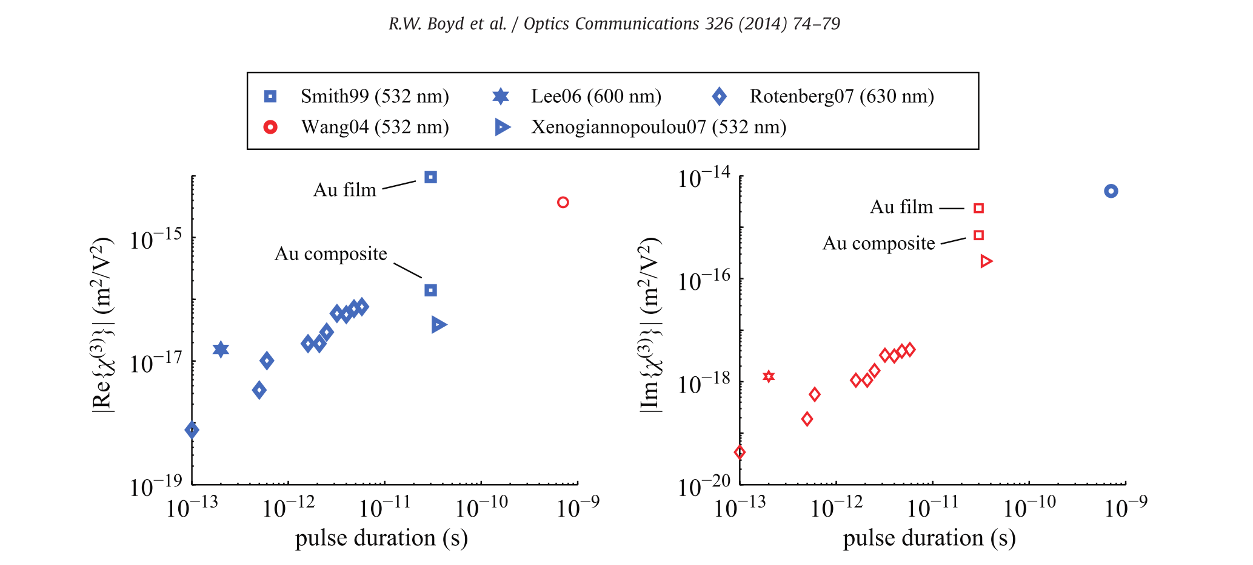
Nonlinear Experimental data
Robert W. Boyd, Zhimin Shi, and Israel De Leon. The third-order nonlinear optical susceptibility of gold. Optics Communications, 326:74–79, 2014

Slide 4
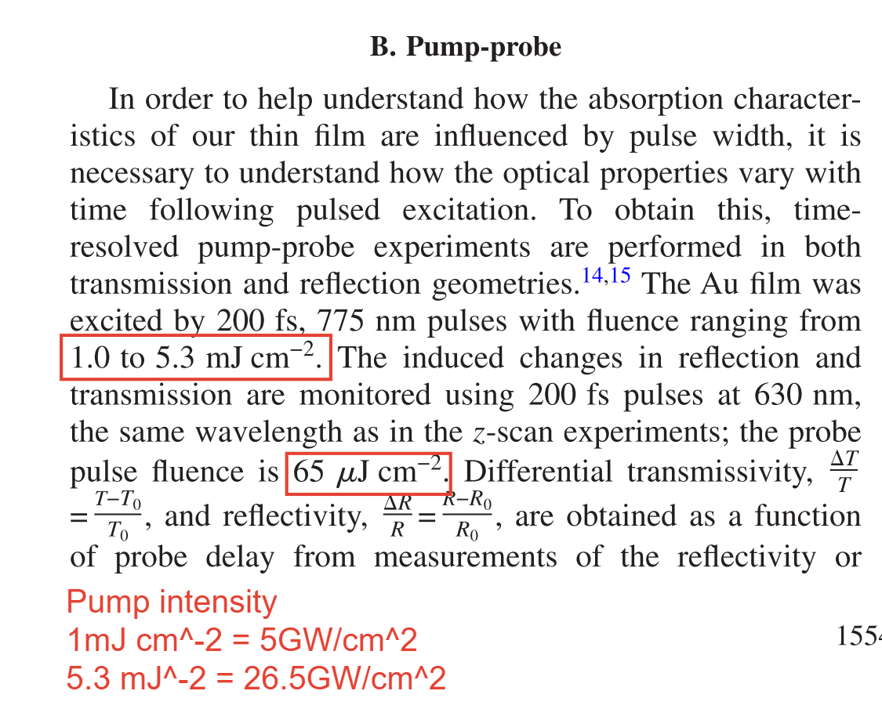
Nonlinear Experimental data
Usually, our simulation intensity should be smaller than the experimental intensity.
Because of the reflection, scattering, focusing …
Here they use the 20nm thick Au film
on microscope slide with 630 nm laser
N. Rotenberg, A.D. Bristow, M. Pfeiffer, M. Betz, H.M. van Driel, Phys. Rev. B 75 (2007) 155426

Slide 5
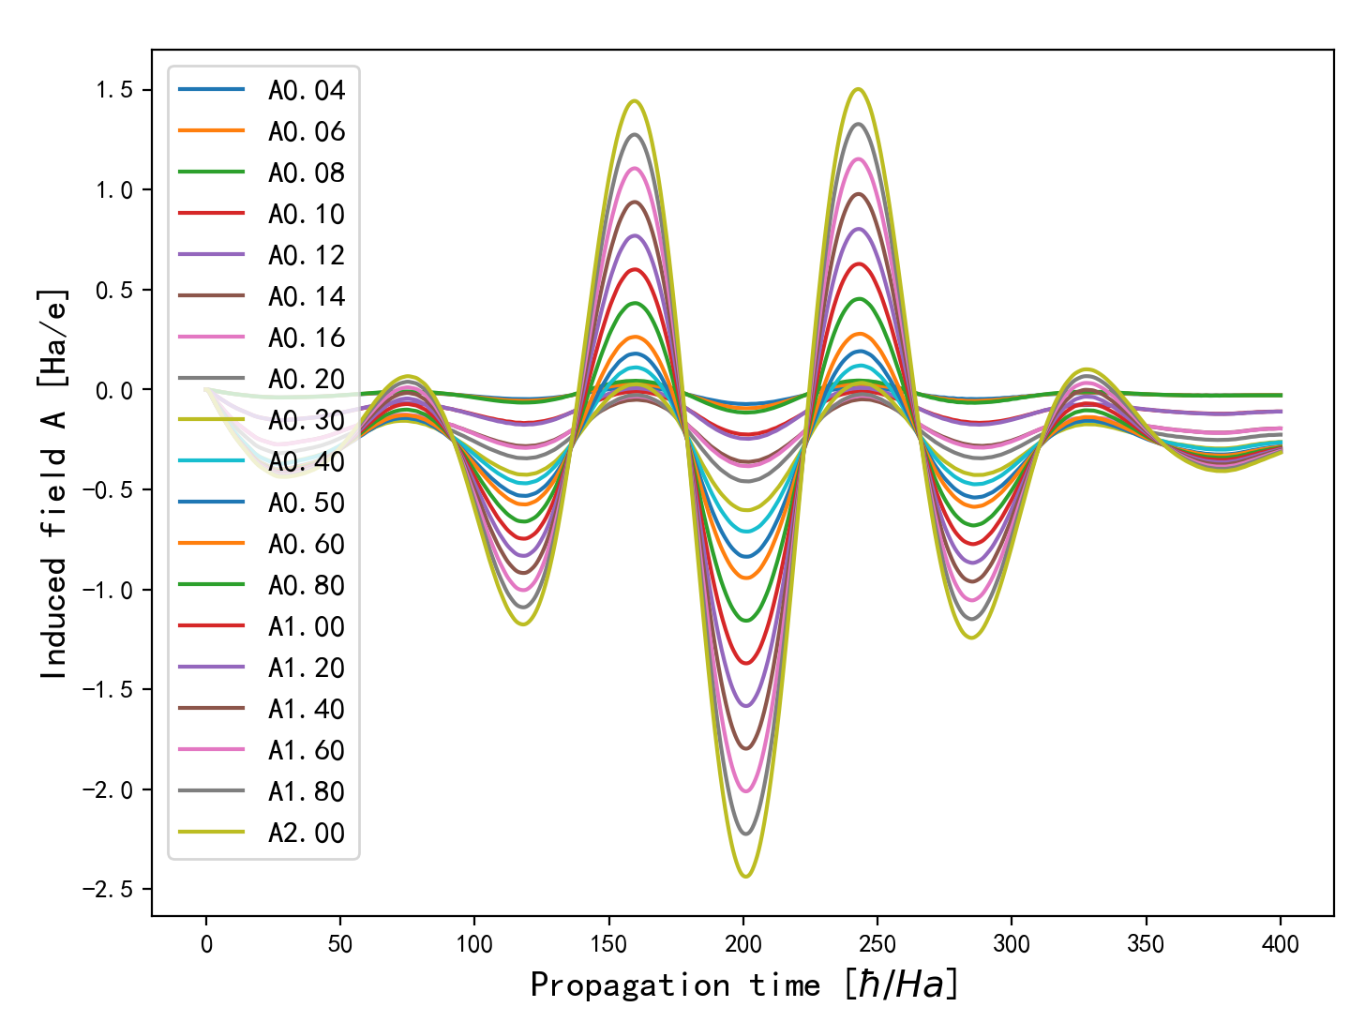
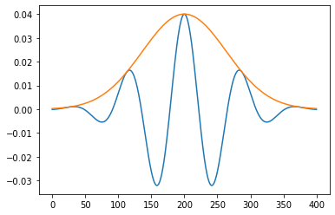
Find the amplitude range of external field A
Gaussian shape Propagation time = 400 [hbar/Ha] dt = 0.2 [hbar/Ha]
A= [0.04, 0.06, 0.08, 0.1, 0.12, 0.14, 0.16, 0.2, 0.3, 0.4, 0.5, 0.6, 0.8, 1, 1.2, 1.4, 1.6,1.8, 2] Ha/e
Intensity = [0.02, 0.04, 0.06, 0.10, 0.14, 0.19, 0.25, 0.39, 0.88, 1.56, 2.44, 3.52, 6.26, 9.78, 14.08,
19.16, 25.02, 31.67, 39.10 ] GW/cm^2
Spacing = 0.5 [Bohr] k = 20 LDA

Slide 6
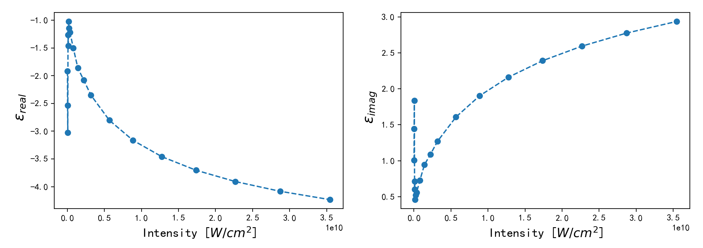
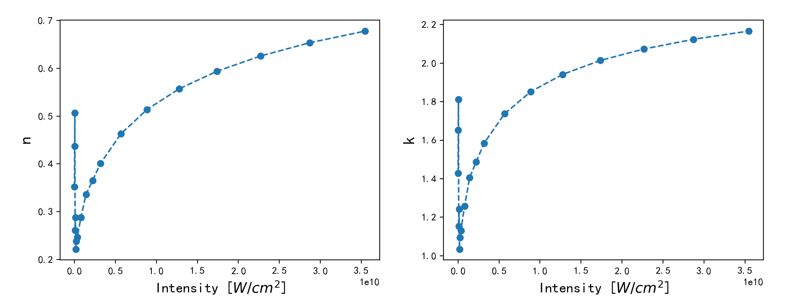
saturation
Linear range
(should be flatten)
Nonlinear

Slide 7
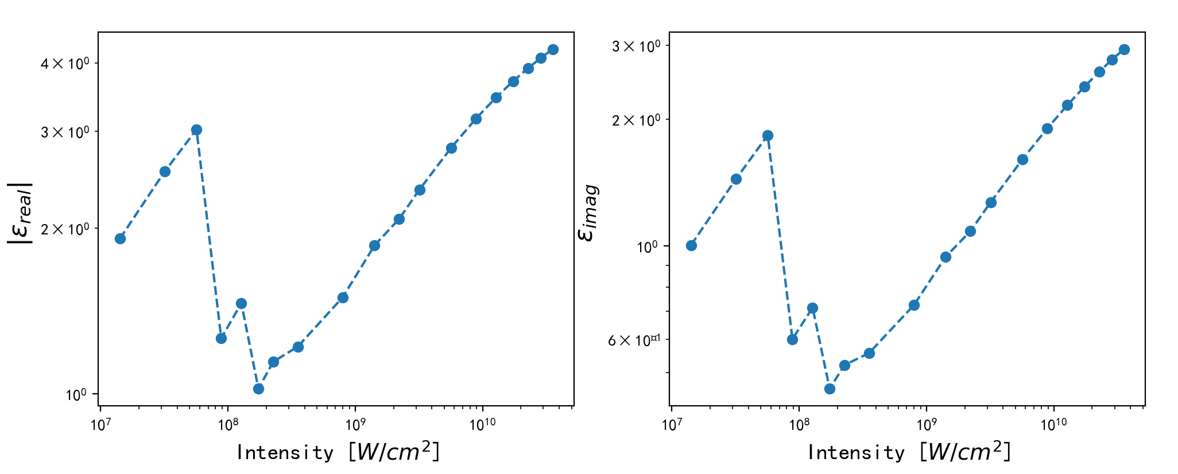
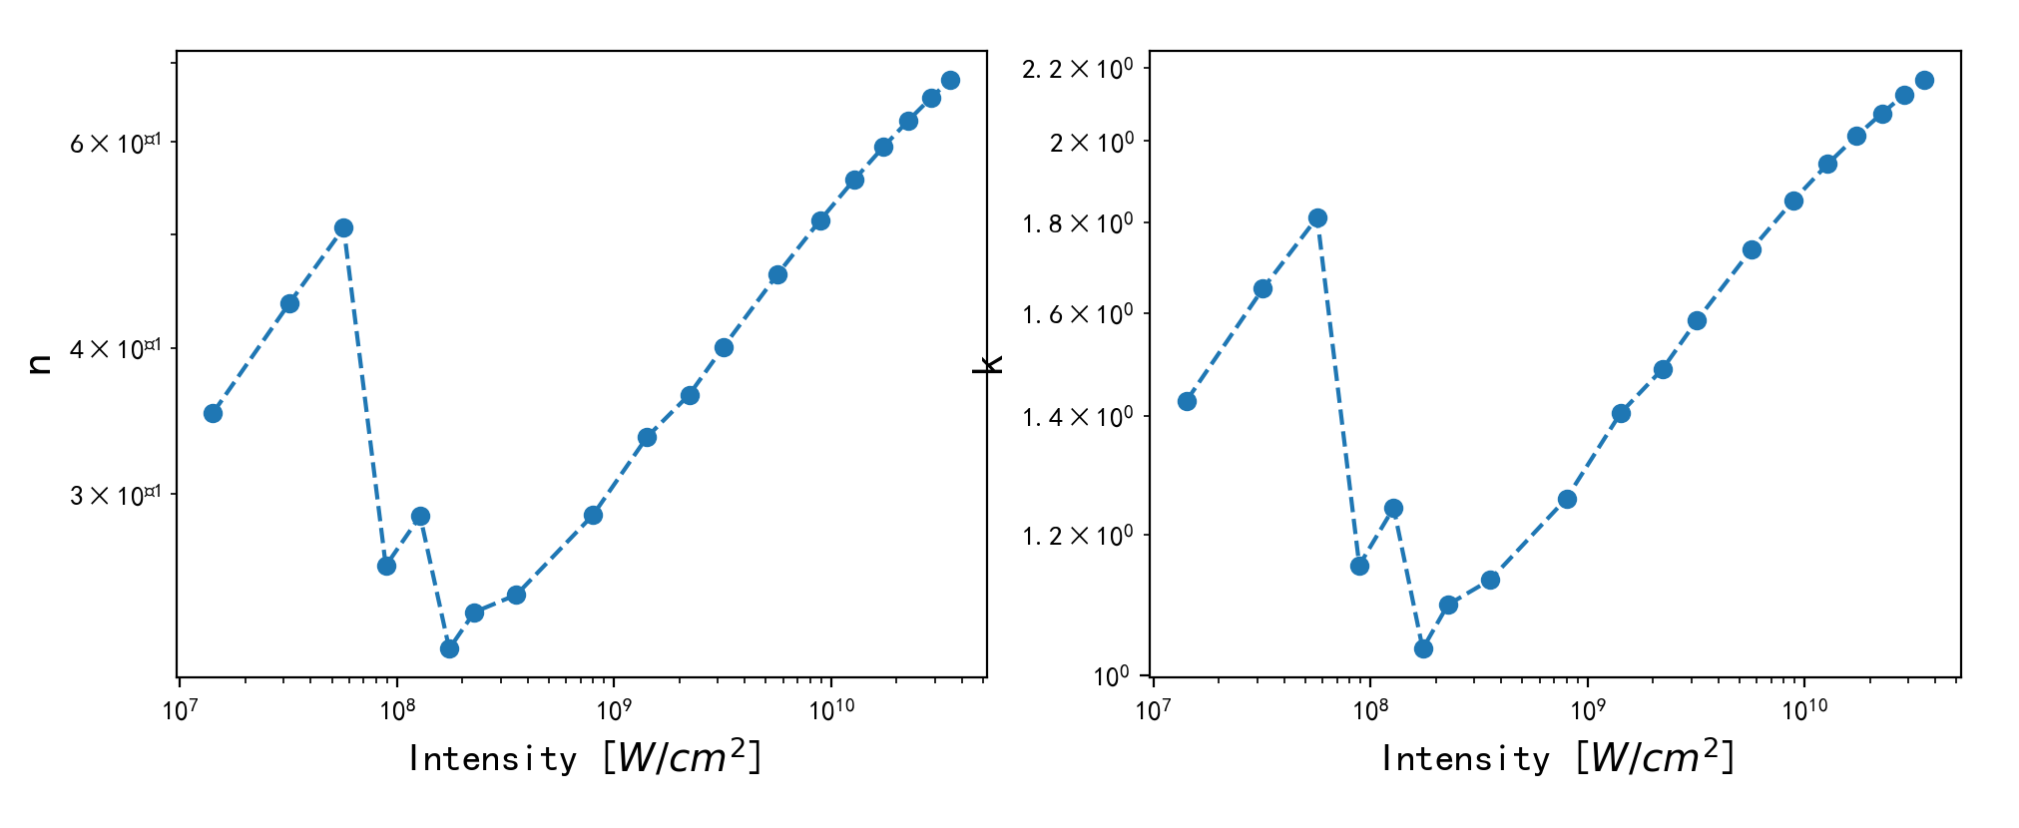
Double log coordinate system
Linear
saturation
Nonlinear

Slide 8
Choose the amplitude range A = [0.16, 0.20, 0.30, 0.40] Ha/e
A = 0.40
A = 0.30
A = 0.16
A = 0.20

Slide 9
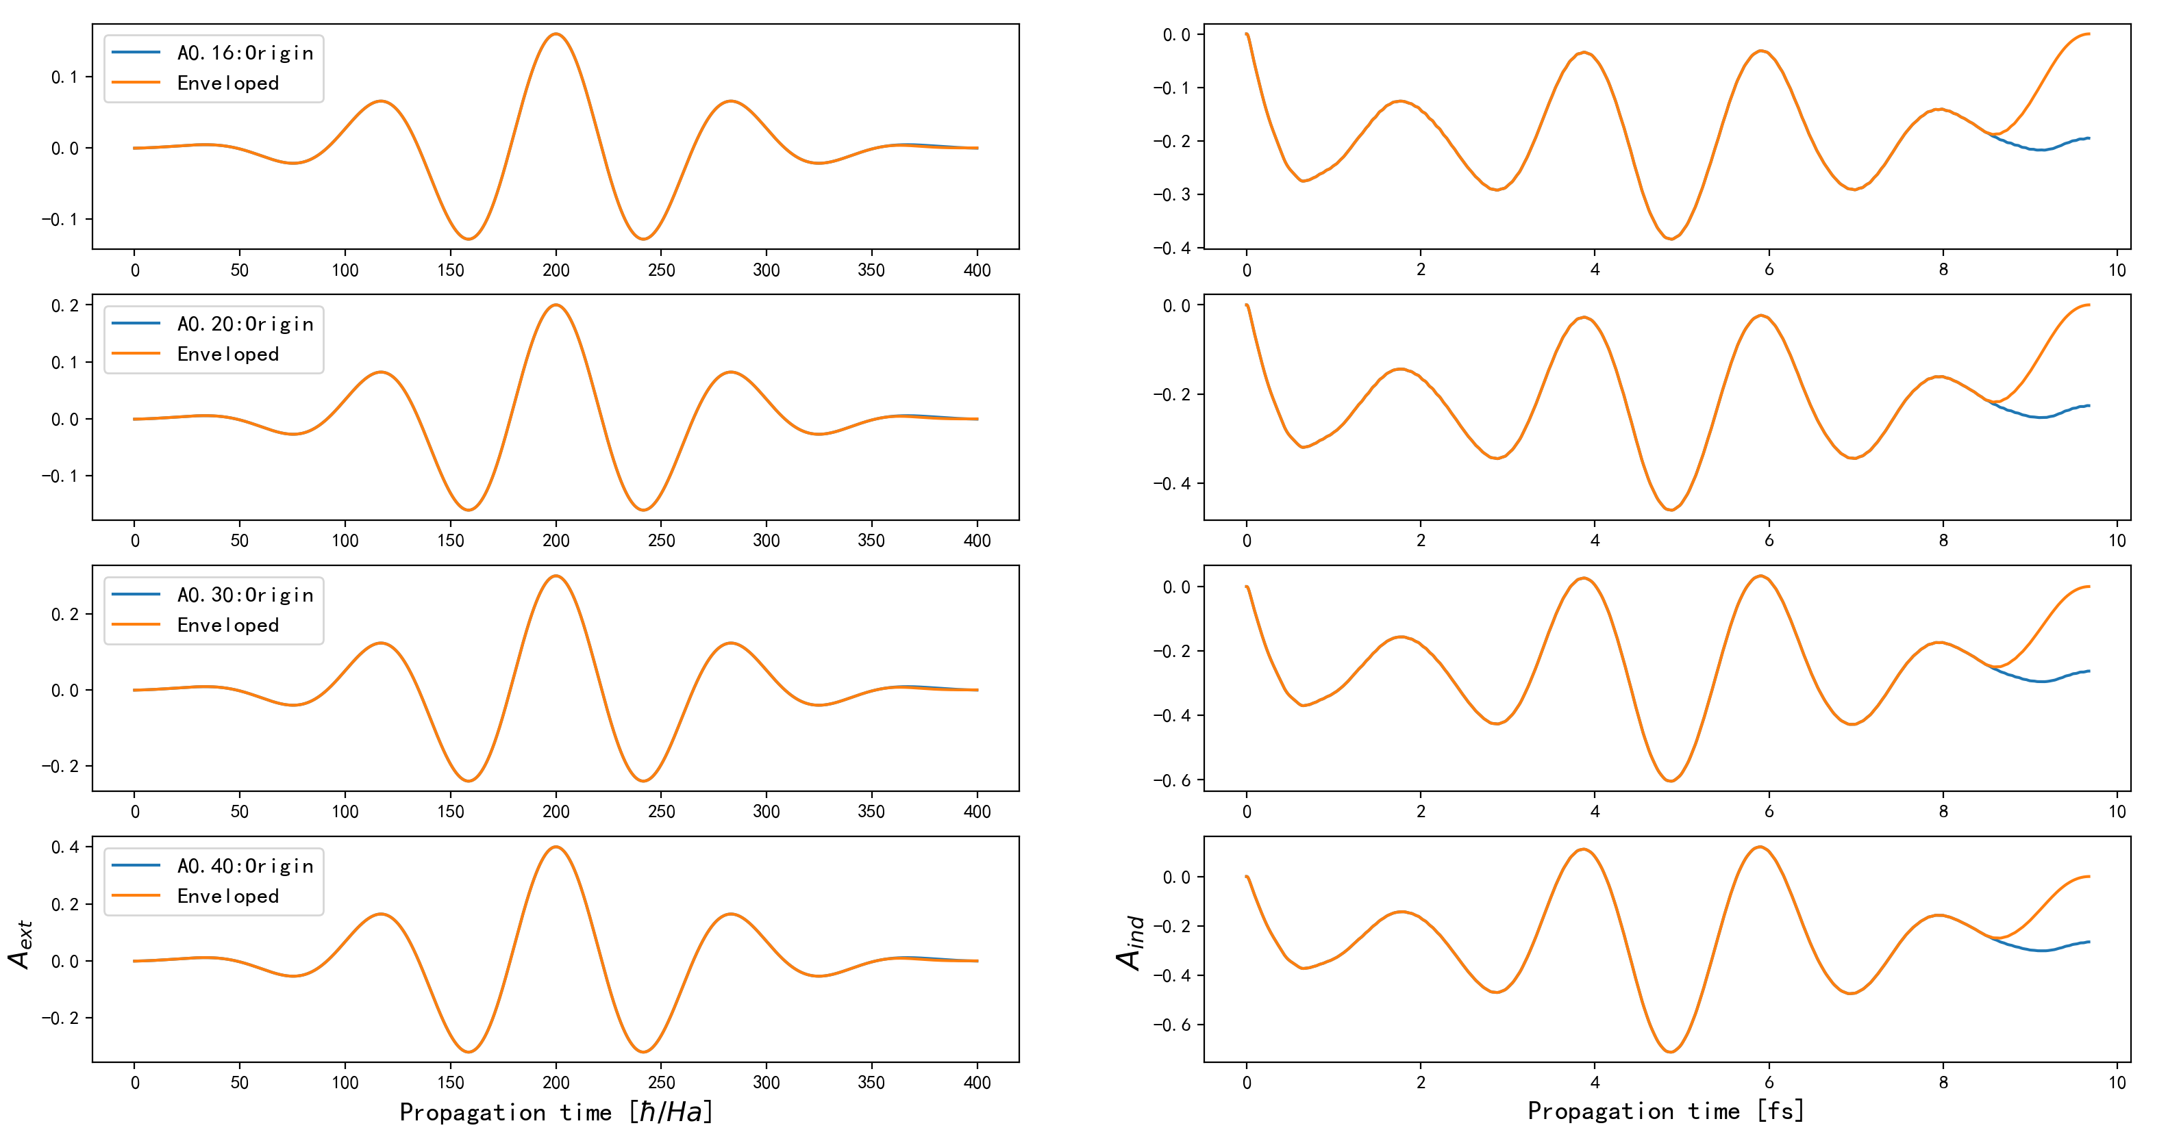
Choose the amplitude range A = [0.16, 0.20, 0.30, 0.40] Ha/e

Slide 10
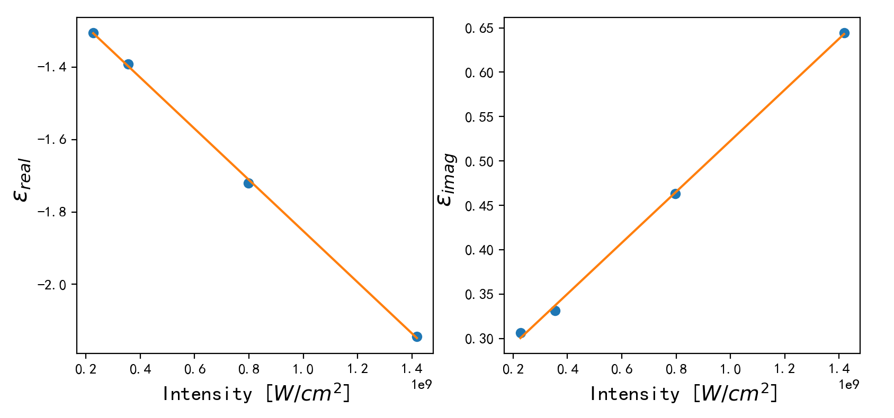
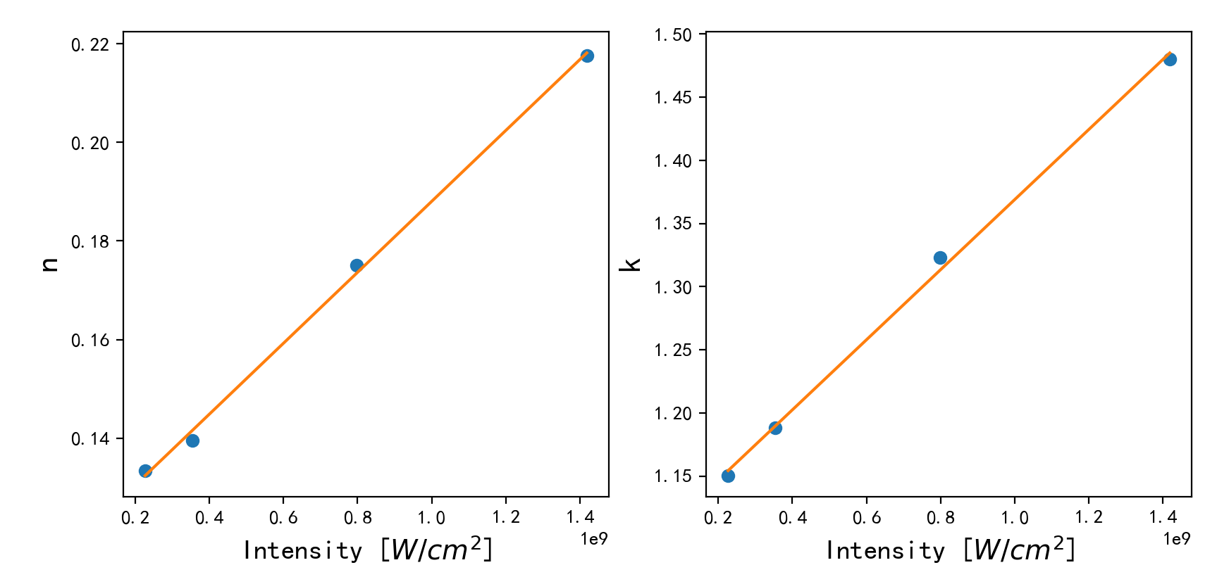
Choose the amplitude range A = [0.16, 0.20, 0.30, 0.40] Ha/e

Slide 11
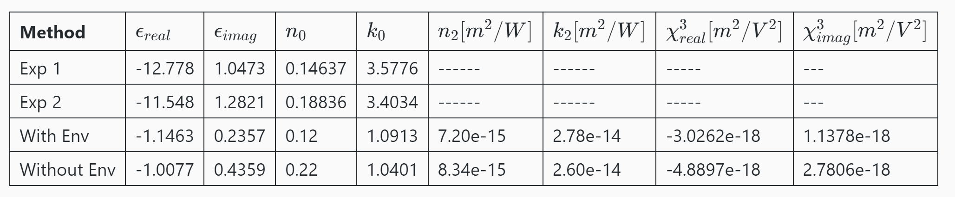
Choose the amplitude range A = [0.16, 0.20, 0.30, 0.40] Ha/e

Slide 12
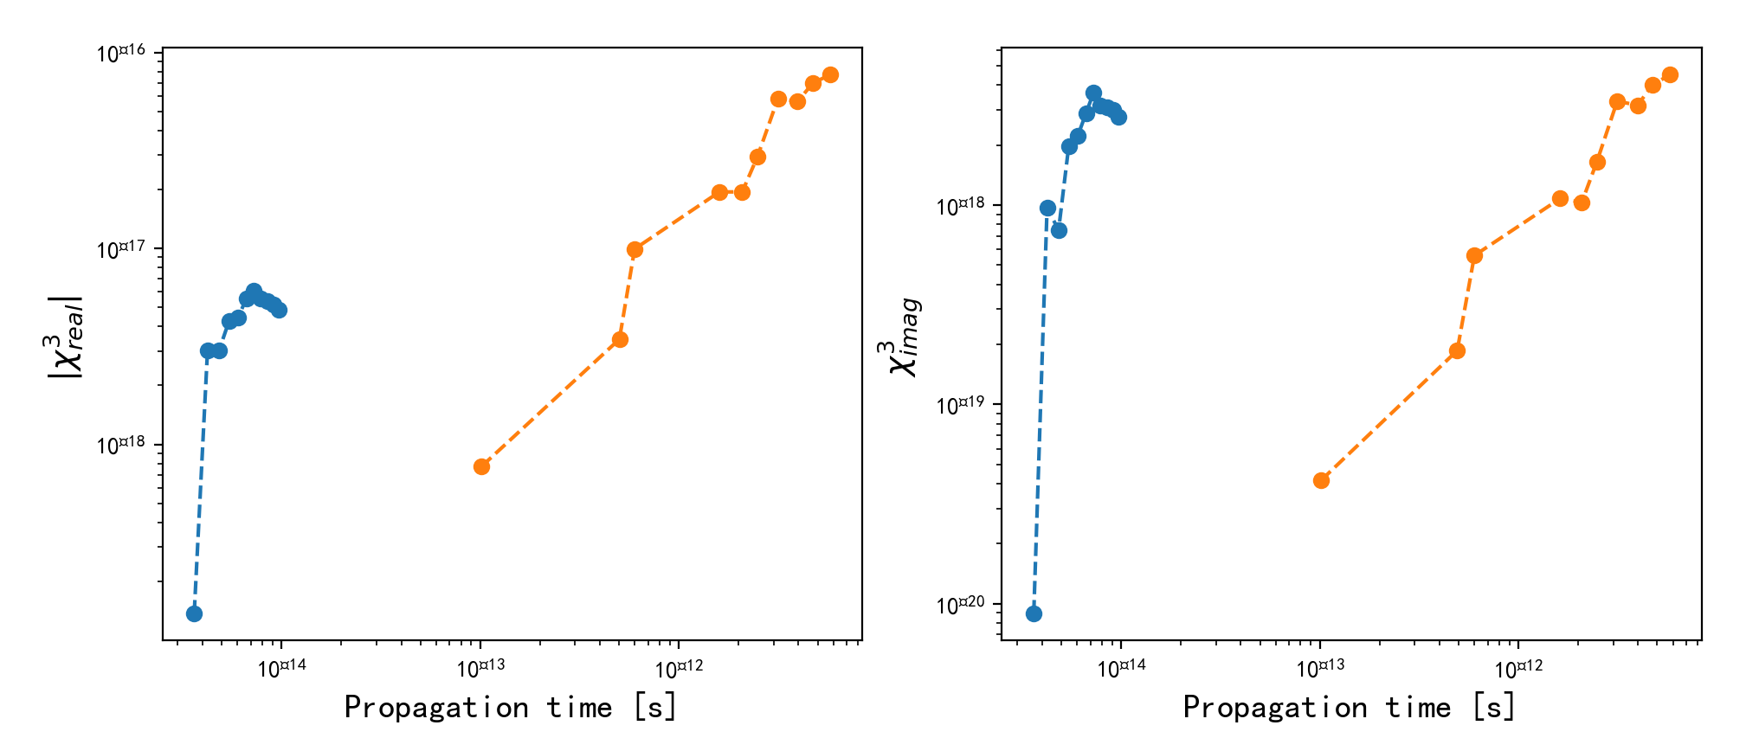
Choose the amplitude range A = [0.16, 0.20, 0.30, 0.40] Ha/e
Exp
TDDFT
Robert W. Boyd, Zhimin Shi, and Israel De Leon. The third-order nonlinear optical susceptibility of gold. Optics Communications, 326:74–79, 2014

Slide 13
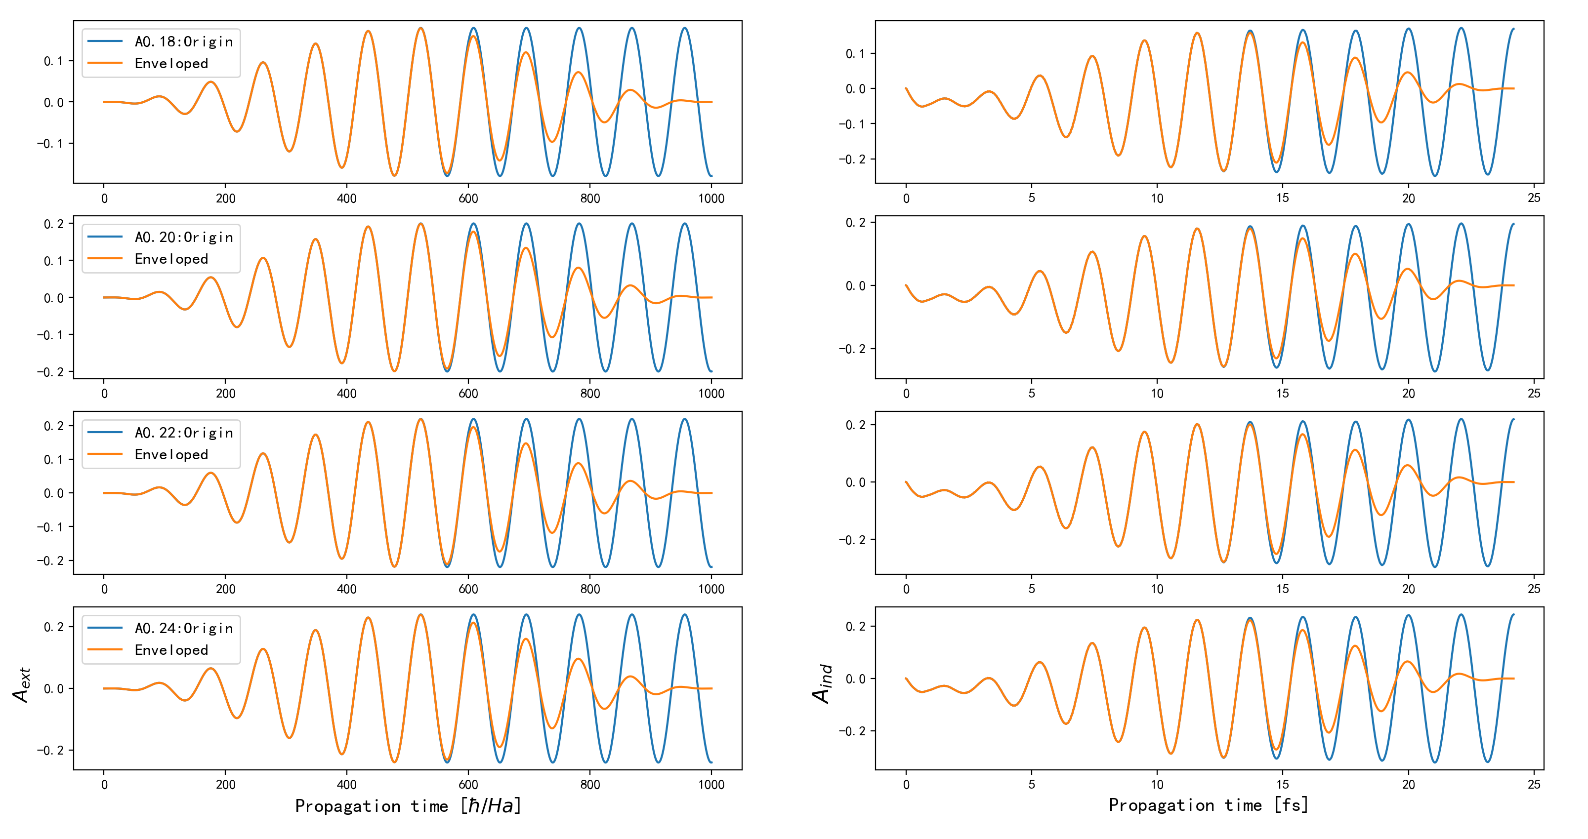
Amplitude range A = [0.18, 0.20, 0.22, 0.24] Ha/e

Slide 14
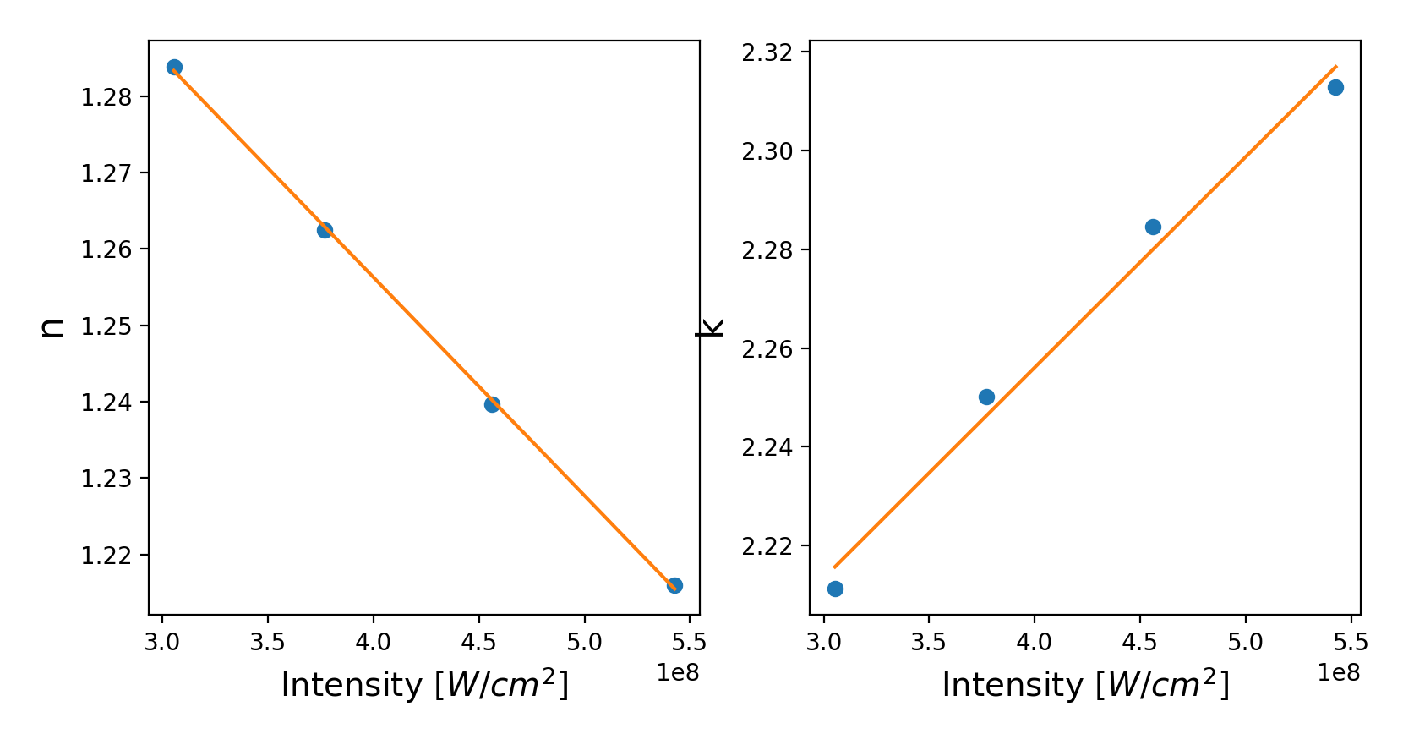
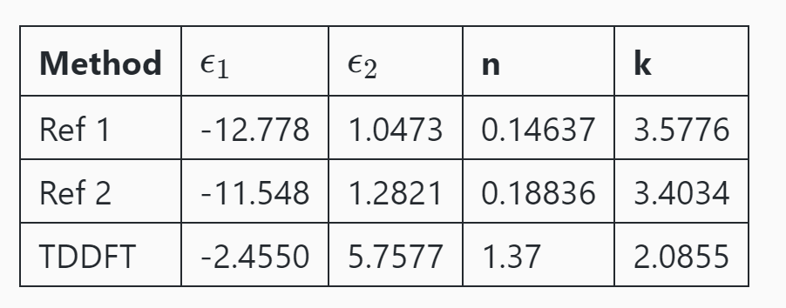
Amplitude range A = [0.18, 0.20, 0.22, 0.24] Ha/e

Slide 15
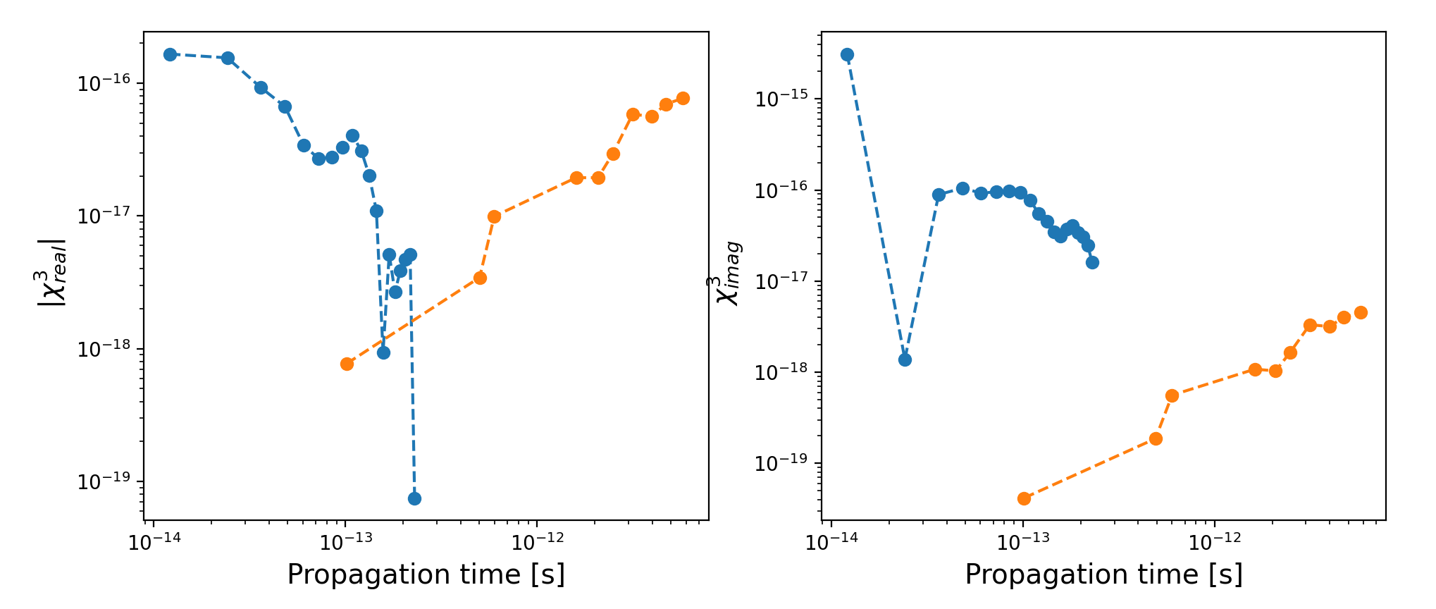
Amplitude range A = [0.18, 0.20, 0.22, 0.24] Ha/e with envelope

Slide 16
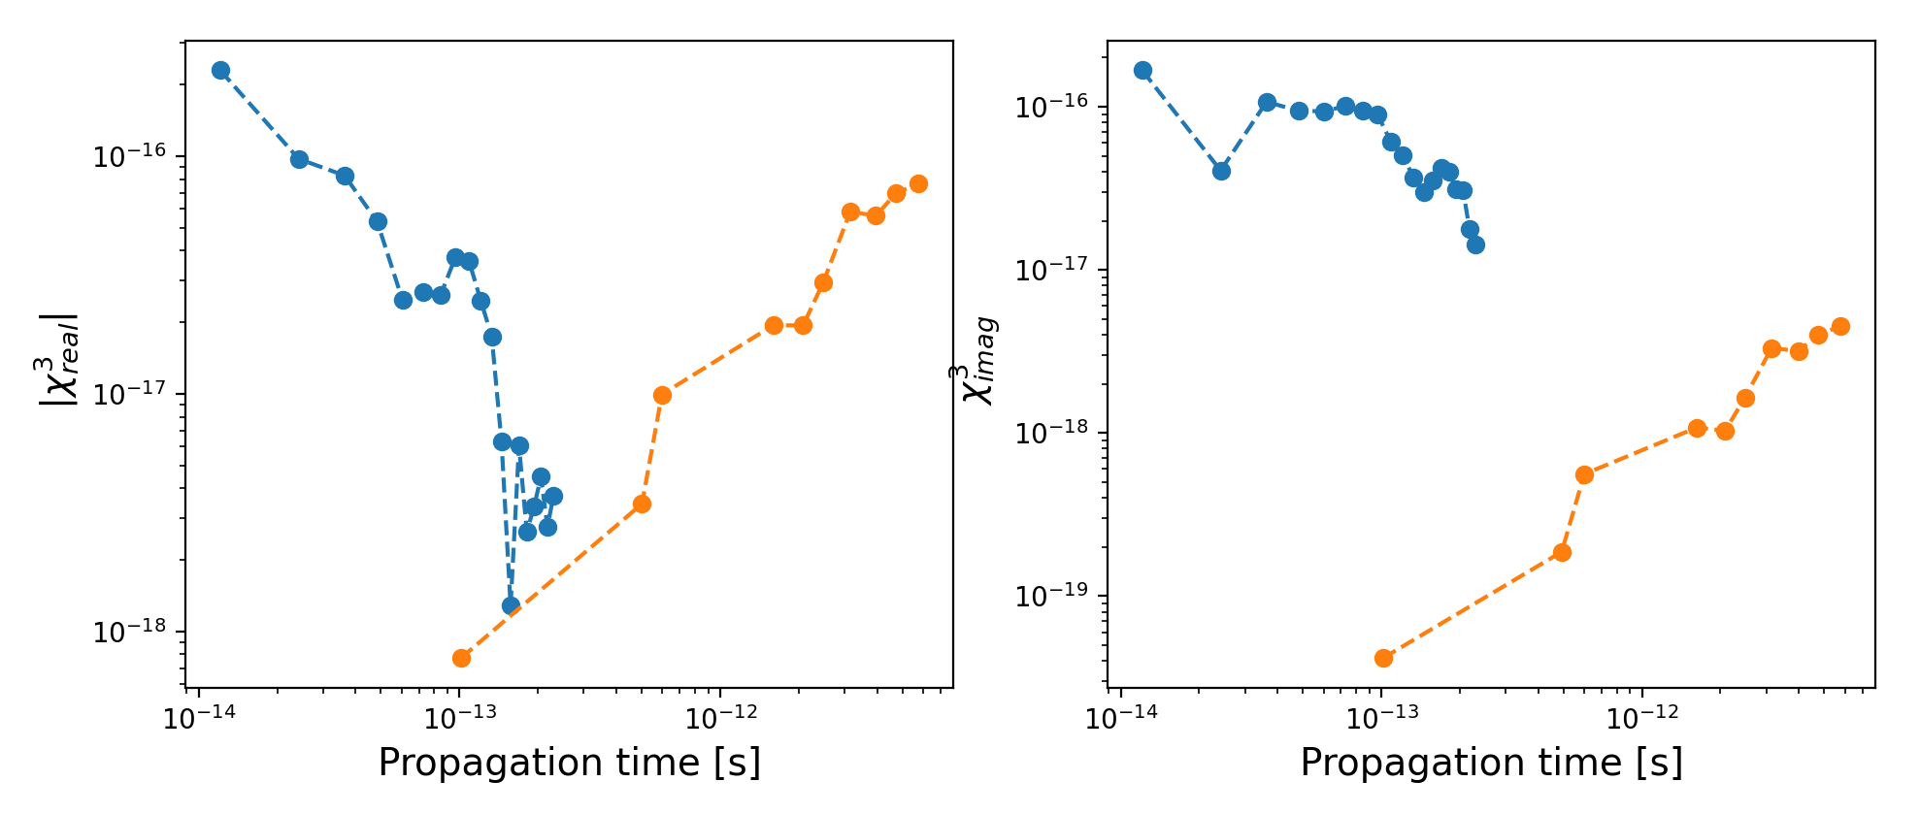
Amplitude range A = [0.18, 0.20, 0.22, 0.24] Ha/e without envelope

Slide 17
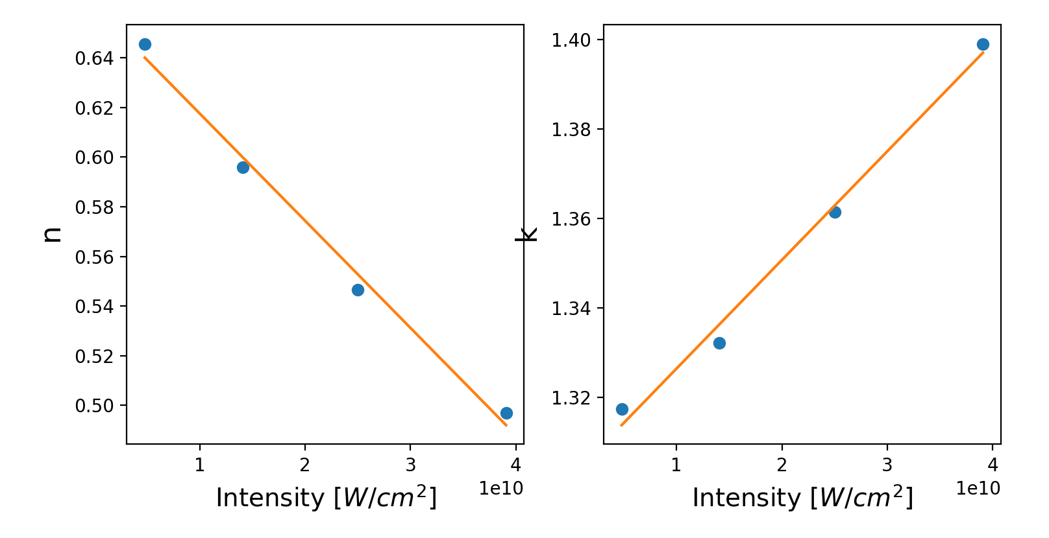
Amplitude range A = [0.7, 1.2, 1.6, 2] Ha/e T = 5000 au

Slide 18
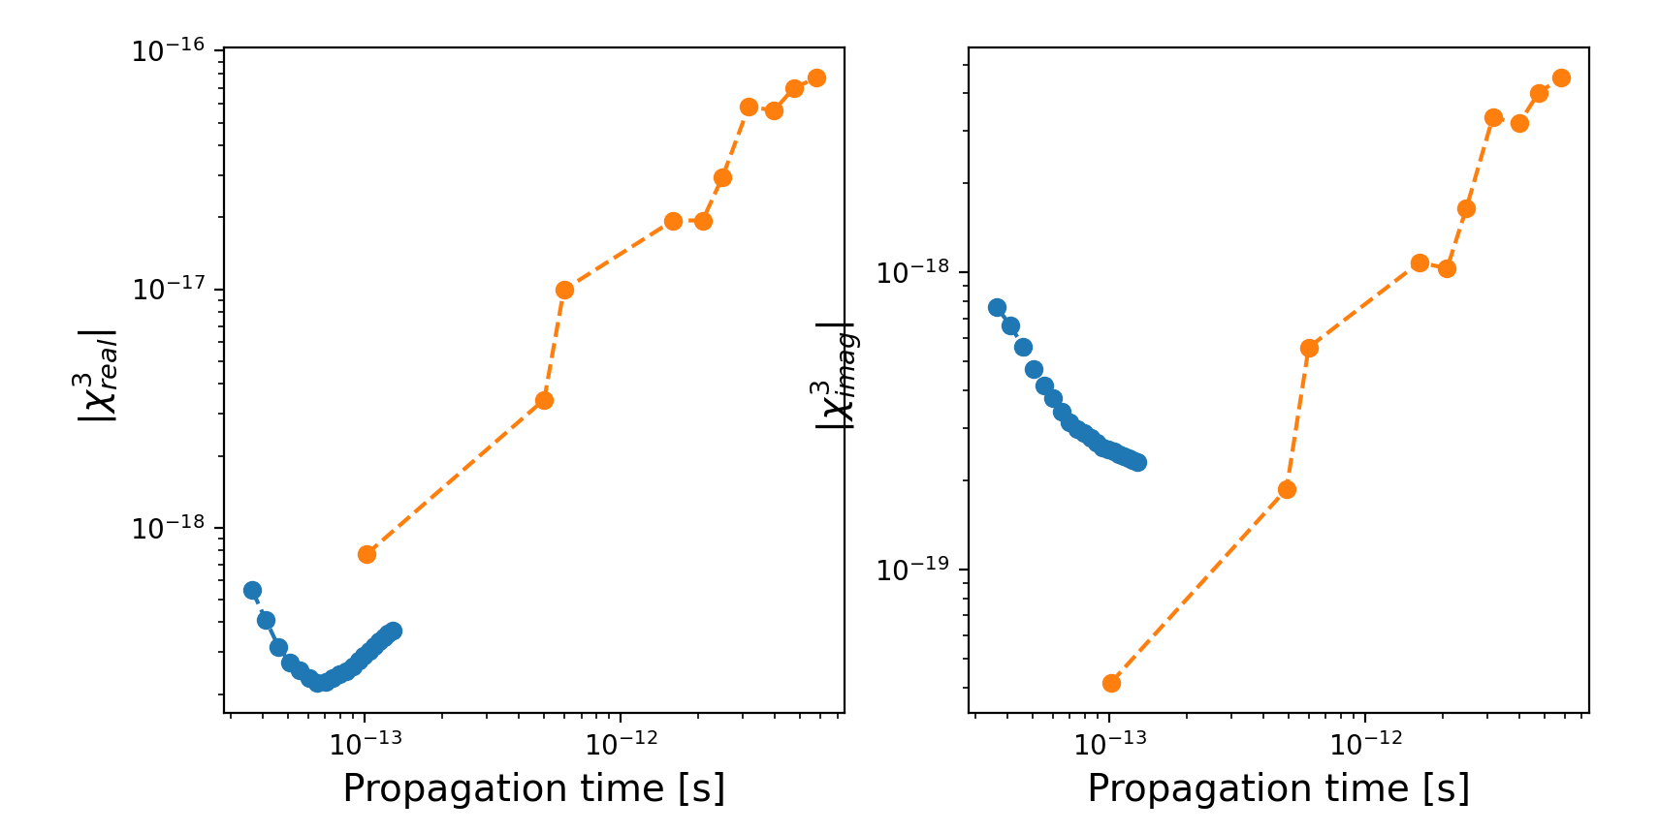
Amplitude range A = [0.7, 1.2, 1.6, 2] Ha/e

Slide 19
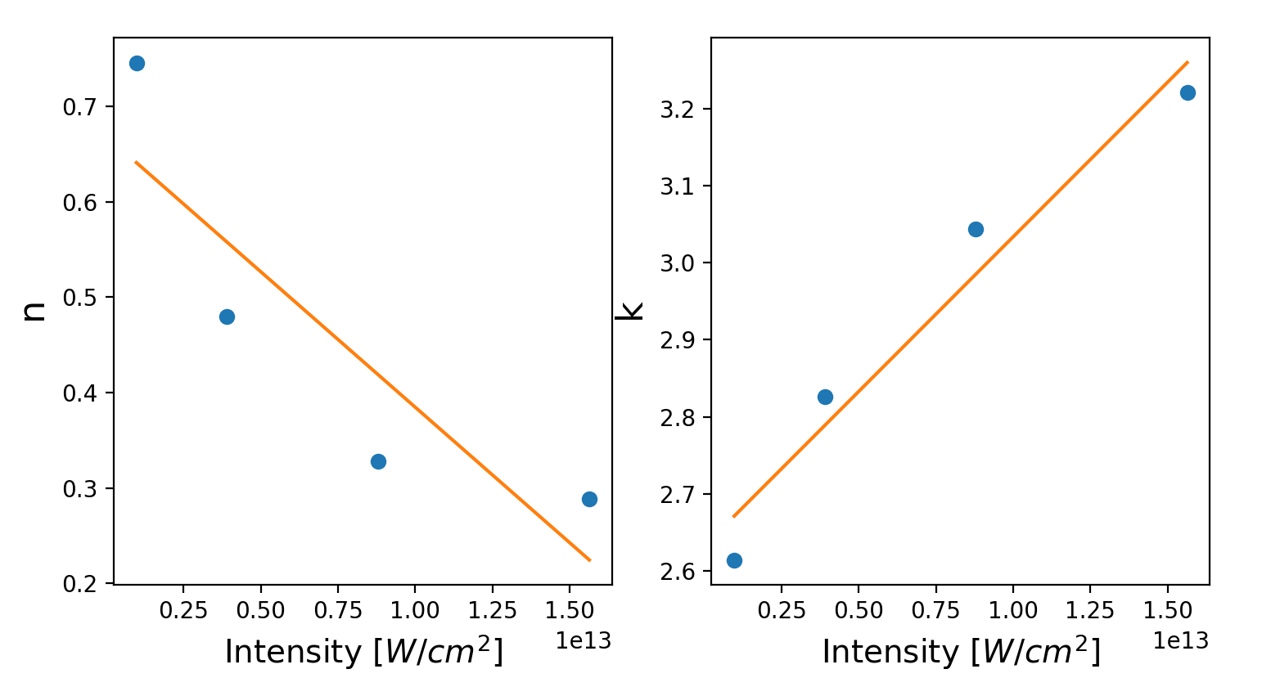
Amplitude range A = [10,20, 30,40] Ha/e without envelope
T = 1000, Env, tail = 200

Slide 20
Amplitude range A = [10,20, 30,40] Ha/e
Emax = max(cx.A2E(time, A_ext)) I1 = cx.E2I(Emax, 1)
IntensityMode = 1
IntensityMode = 2
c = 137.03604 Iau = max(A_ext) * omega / c I2 = np.square(Iau * np.sqrt(3.509470 * 1e16))
IntensityMode = 3
I3 = cx.E2I(Emax, n00=0.18)
modification = epsilon_real Emax = max(cx.A2E(time, A_ext)) / modification # epsilon modification I4= cx.E2I(Emax, n_real)
IntensityMode = 4
modification = - 12 Emax = max(cx.A2E(time, A_ext)) / modification # epsilon modification I5= cx.E2I(Emax, n_real) # [W/cm^2] # cited from the 'n0n2k0k2' paper
IntensityMode = 5

Slide 21
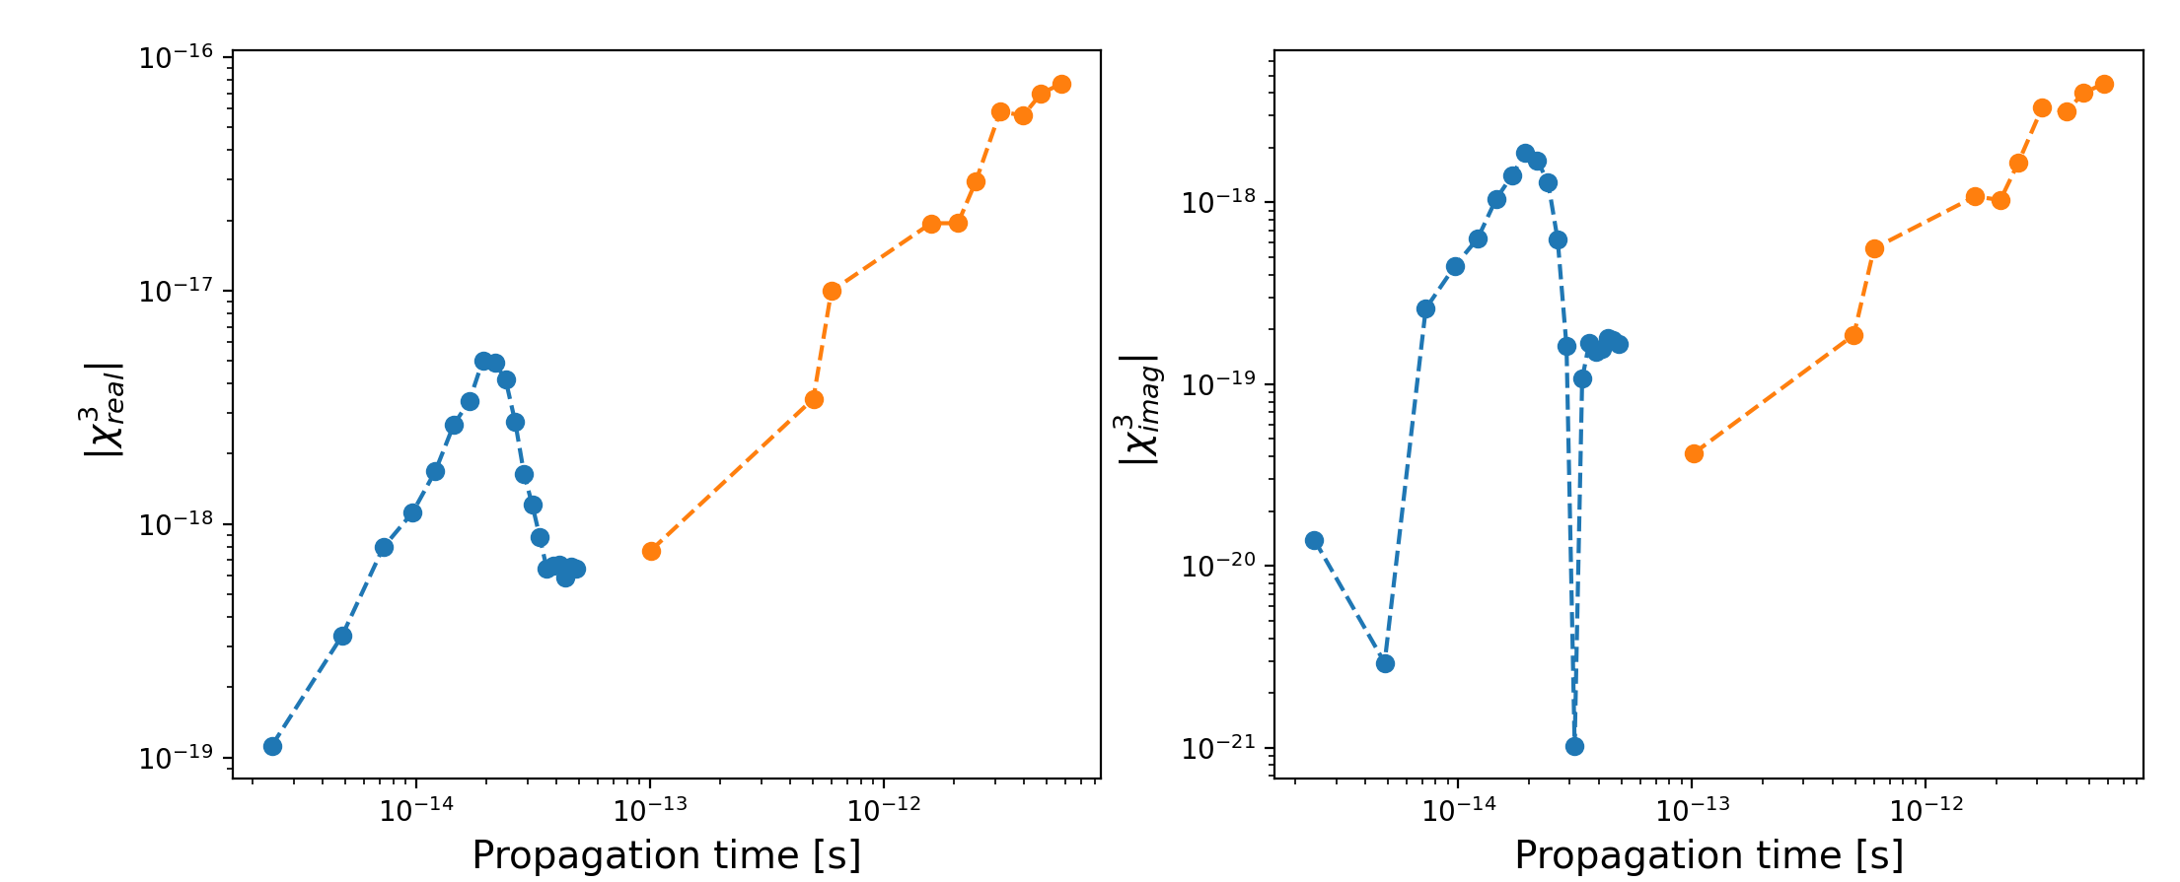
Amplitude range A = [10,20, 30,40] Ha/e without envelope
TimeRange = np.arange(100,2100,100) N0,N2,K0,K2,CHI3R,CHI3I = c3.TimeEnvolution(path3, lasermode=2, Timestep=0.05, Time = TimeRange, Tail=500, wavelength = 630, n00 = 1, Env = False, IntensityMode = 4, plot = False)

Slide 22
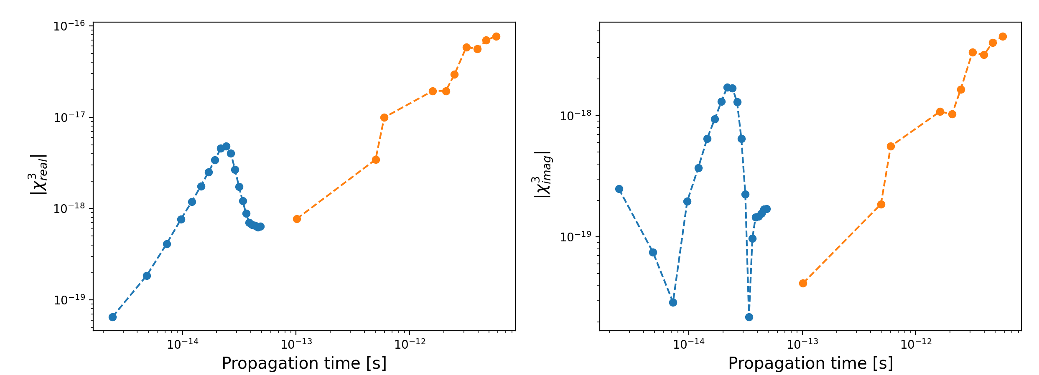
Amplitude range A = [10,20, 30,40] Ha/e with envelope
TimeRange = np.arange(100,2100,100) N0,N2,K0,K2,CHI3R,CHI3I = c3.TimeEnvolution(path3, lasermode=2, Timestep=0.05, Time = TimeRange, Tail=200, wavelength = 630, n00 = 1, Env = True, IntensityMode = 4, plot = False)

Slide 23
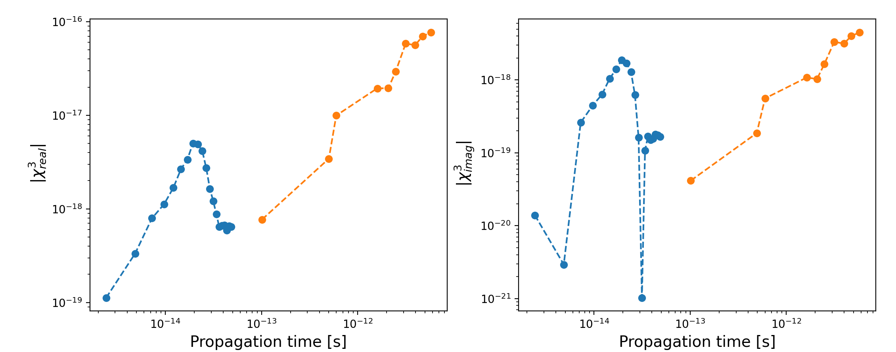
Amplitude range A = [10,20, 30,40] Ha/e without envelope
TimeRange = np.arange(100,2100,100) N0,N2,K0,K2,CHI3R,CHI3I = c3.TimeEnvolution(path3, lasermode=2, Timestep=0.05, Time = TimeRange, Tail=200, wavelength = 630, n00 = 1, Env = False, IntensityMode = 5, plot = False)

Slide 24
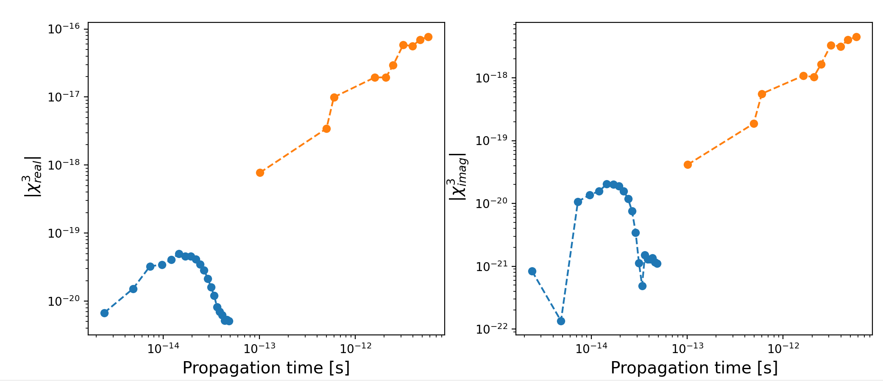
Amplitude range A = [10,20, 30,40] Ha/e without envelope
TimeRange = np.arange(100,2100,100) N0,N2,K0,K2,CHI3R,CHI3I = c3.TimeEnvolution(path3, lasermode=2, Timestep=0.05, Time = TimeRange, Tail=200, wavelength = 630, n00 = 0.18, Env = False, IntensityMode = 3, plot = False)

Slide 25
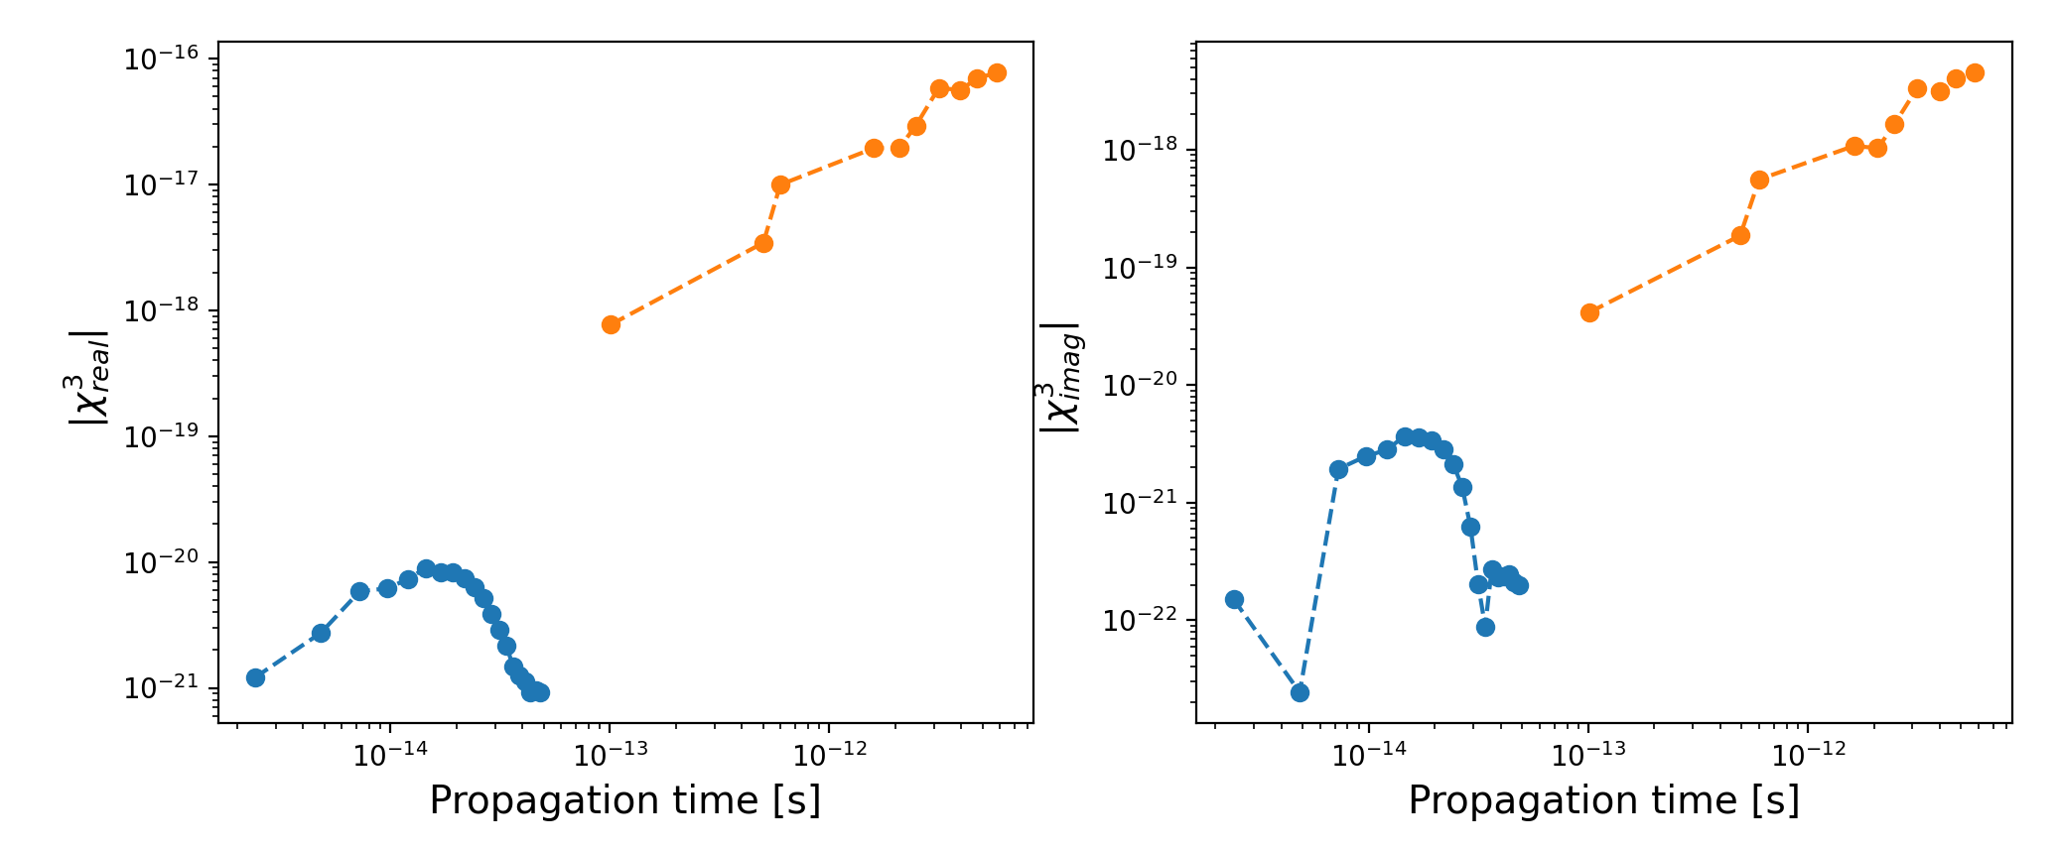
Amplitude range A = [10,20, 30,40] Ha/e without envelope
TimeRange = np.arange(100,2100,100) N0,N2,K0,K2,CHI3R,CHI3I = c3.TimeEnvolution(path3, lasermode=2, Timestep=0.05, Time = TimeRange, Tail=200, wavelength = 630, n00 = 0.18, Env = False, IntensityMode = 1, plot = False)

Slide 26
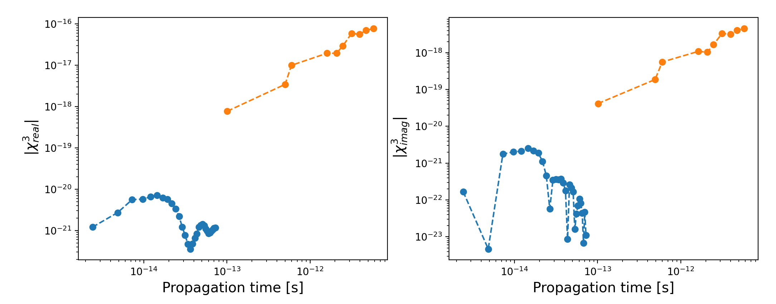
Amplitude range A = [20, 30,40] Ha/e without envelope IntensityMode = 1
TimeRange = np.arange(100,3100,100) N0,N2,K0,K2,CHI3R,CHI3I = c3.TimeEnvolution(path3, lasermode=2, Timestep=0.05, Time = TimeRange, Tail=200, wavelength = 630, n00 = 0.18, Env = False, IntensityMode = 1, plot = False)

Slide 27
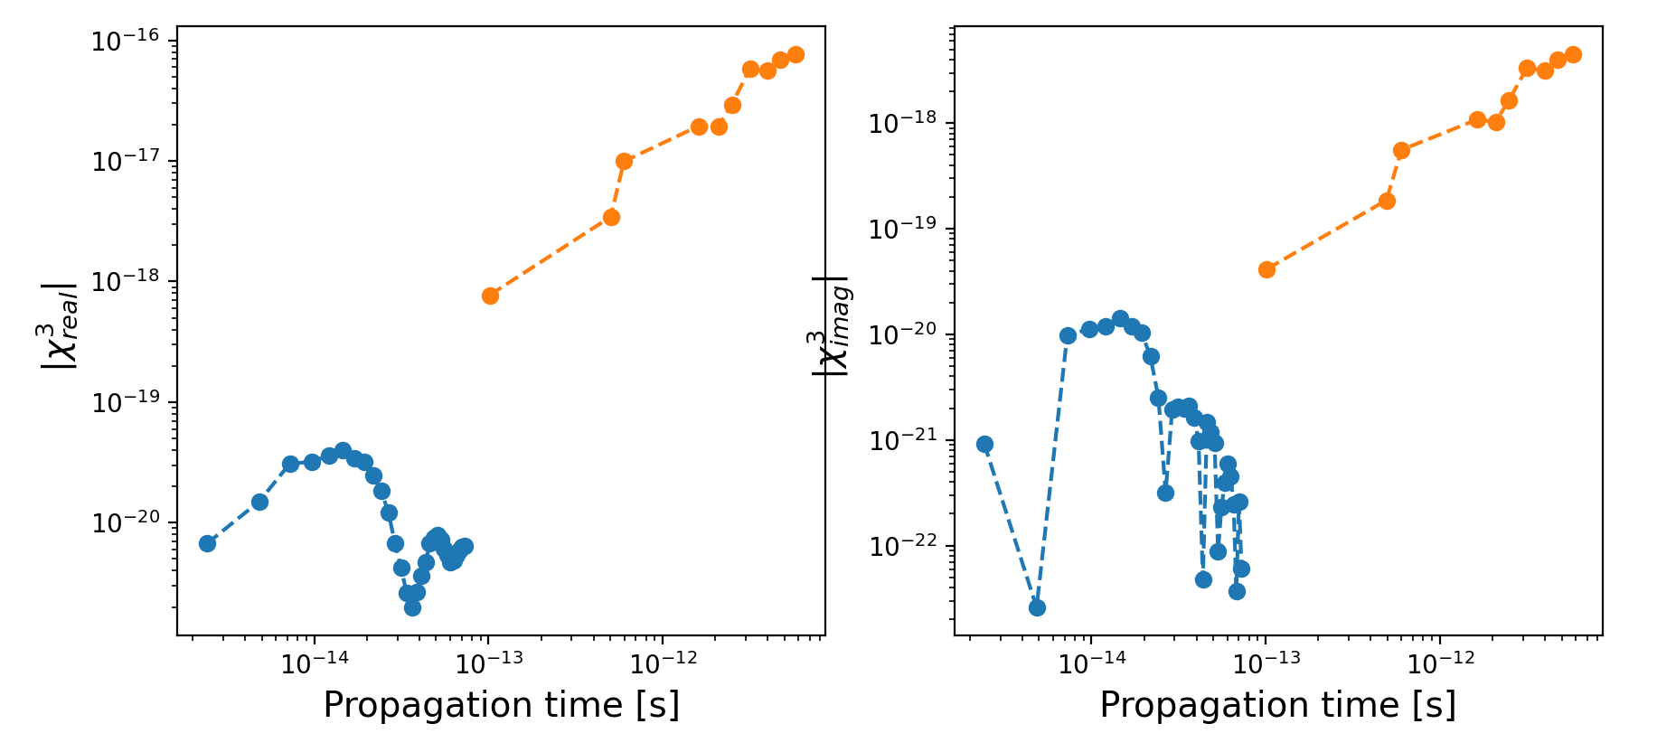
Amplitude range A = [20, 30,40] Ha/e without envelope IntensityMode = 3

Slide 28
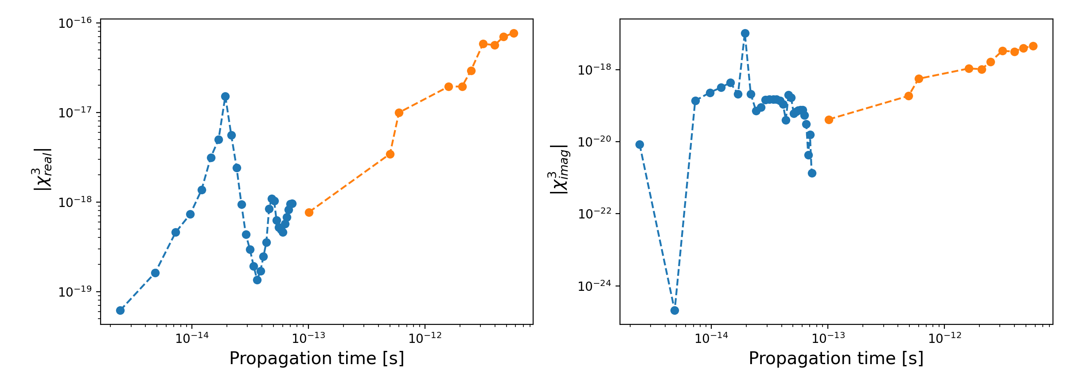
Amplitude range A = [20, 30,40] Ha/e without envelope IntensityMode = 4

Slide 29
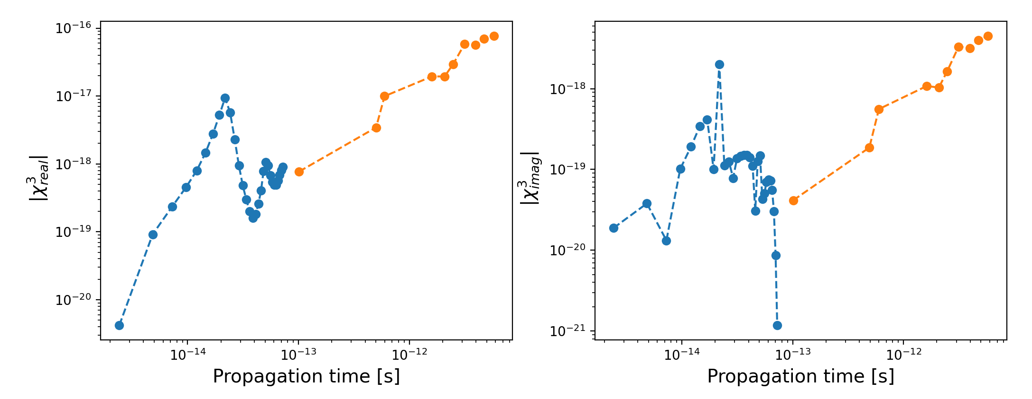
Amplitude range A = [20, 30,40] Ha/e with envelope IntensityMode = 4

Slide 30
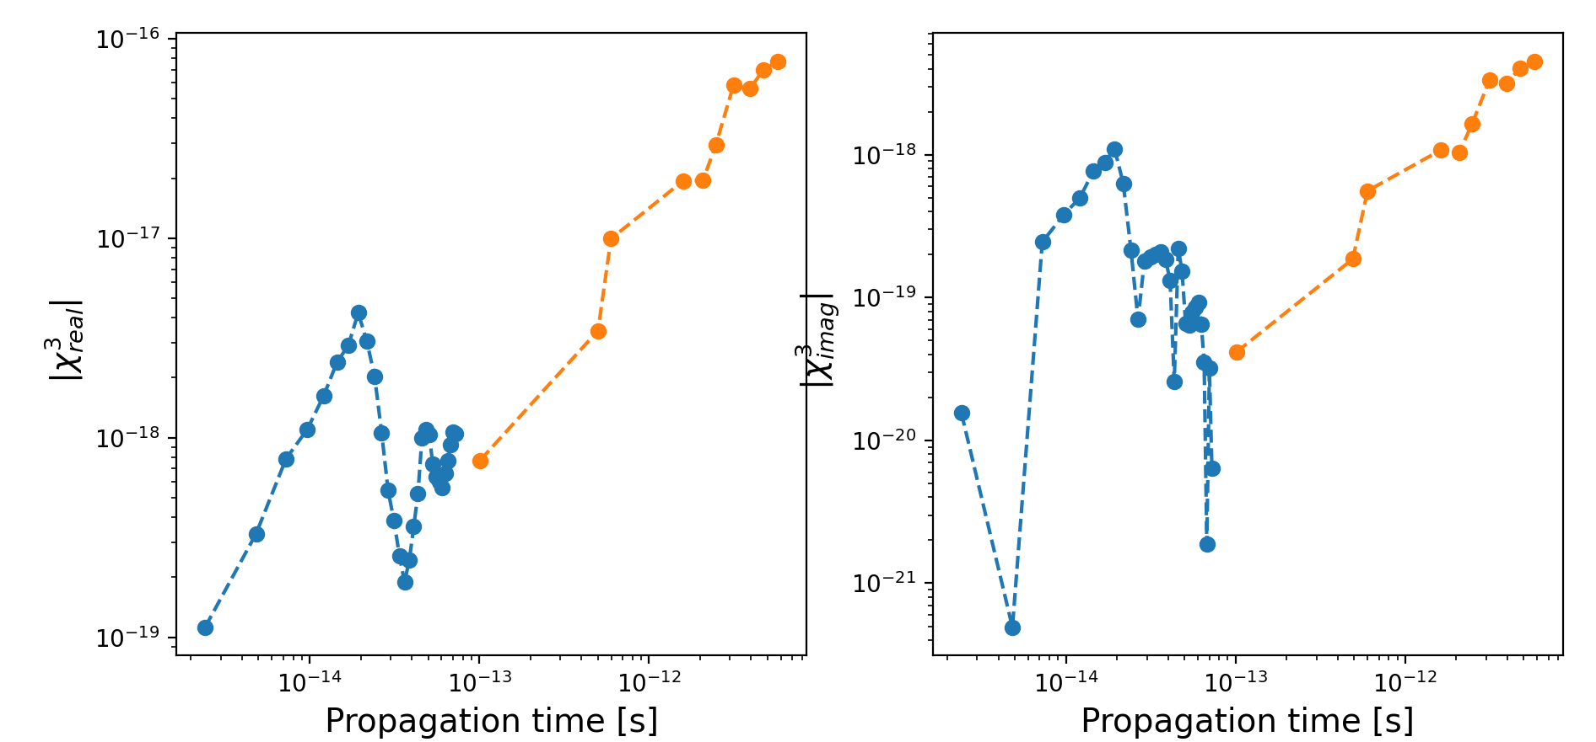
Amplitude range A = [20, 30,40] Ha/e without envelope IntensityMode = 5

Slide 31
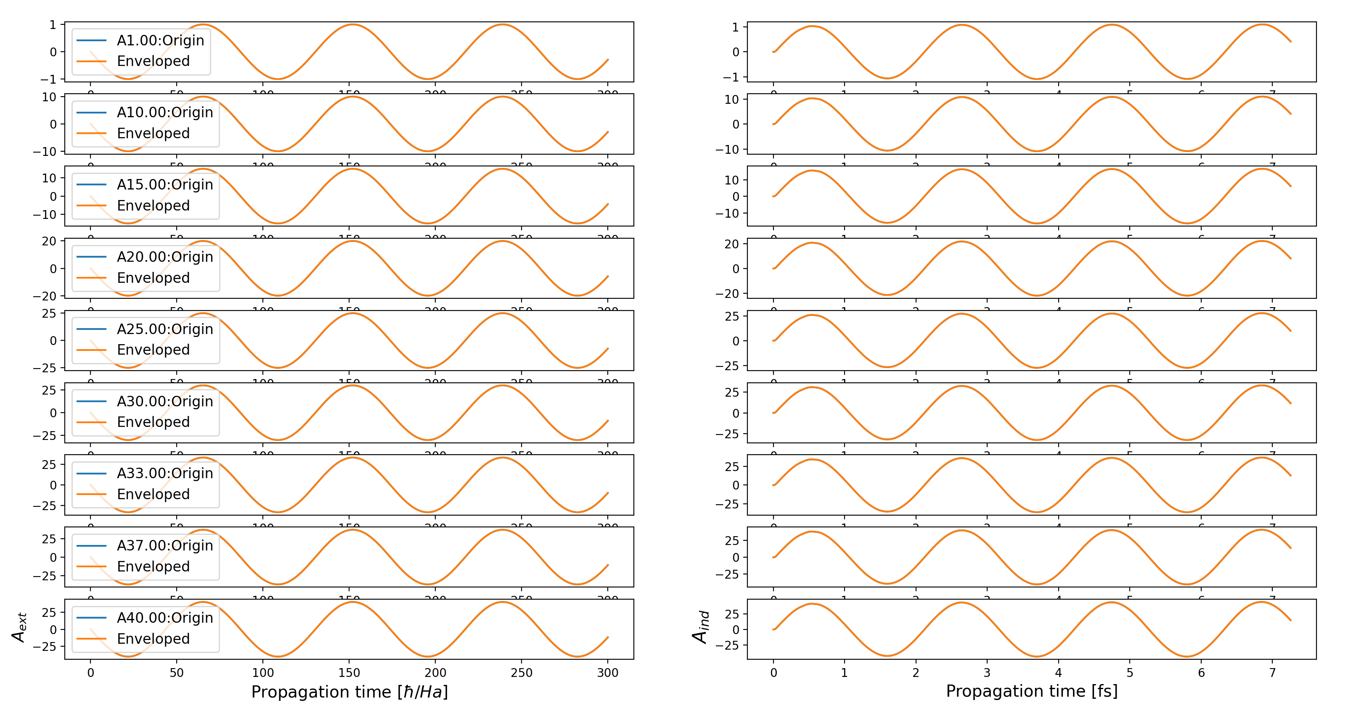
A = [1, 10,15, 20,25,30,33, 37,40] Ha/e

Slide 32
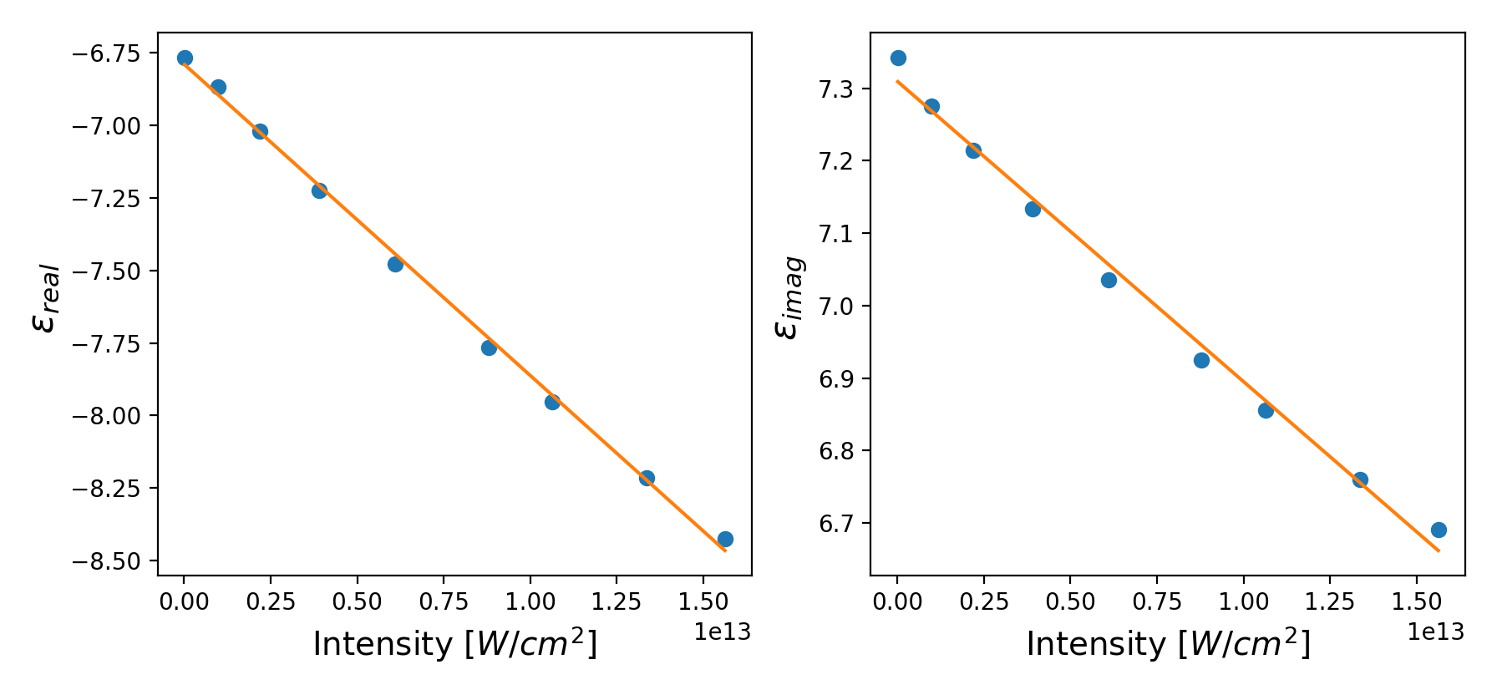
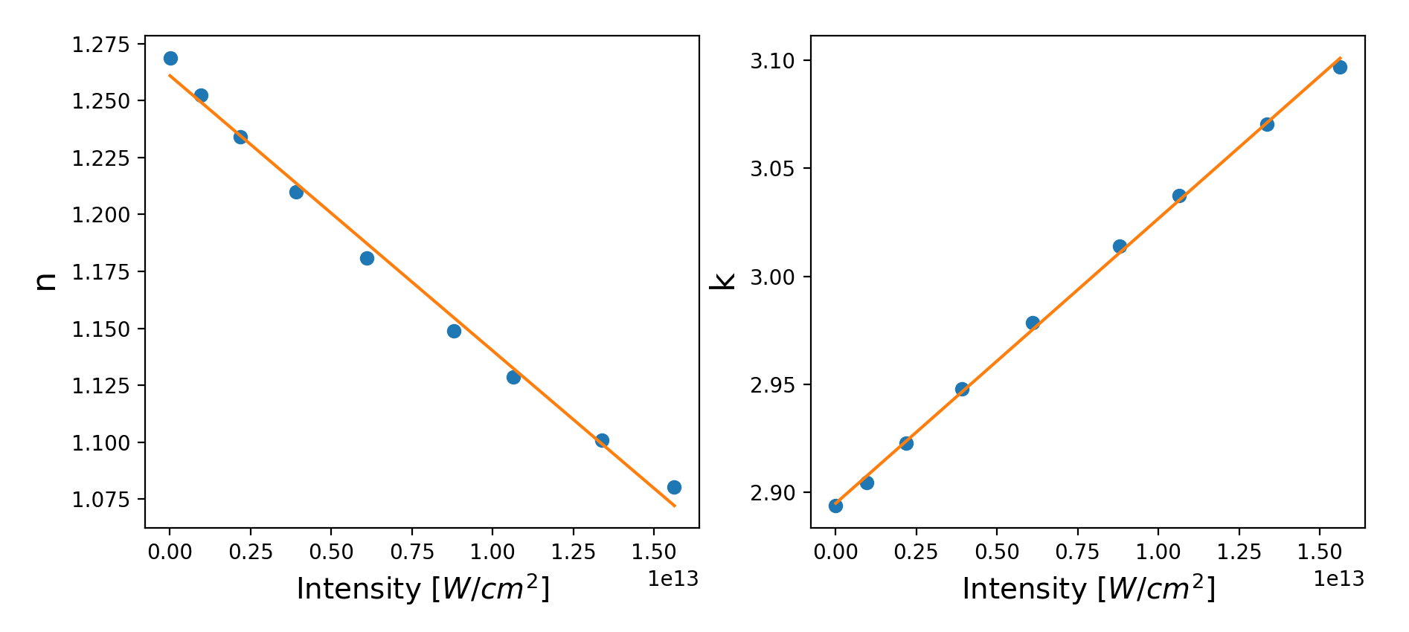
A = [1, 10,15, 20,25,30,33, 37,40] Ha/e

Slide 33
A = [1, 10,15, 20,25,30,33, 37,40] Ha/e

